Slide 1
Senior Design Finance
Go to guide on rules for being a CFO

Slide 2
Supporting Staff

Slide 3
AES FINANCE AND ADMIN TEAM
Please send all requests to aerofinancehelp@colorado.edu.
Laura Clayton - Interim Finance Manager
Tyron Michieli - Temporary Accounting Technician
Additional Team Members:
Jacqui Stang - Accounting Technician: 303-735-0950 (CURRENTLY ON LEAVE)
Email: Jacquelyn.Stang@Colorado.edu
Kayla Vandegrift - Front Desk Manager 303-735-5359
Email: Kayla.Vandegrift@Colorado.edu

Slide 4
How we help you
Jacqui Stang and Tyron Michieli, Accounting Technicians
Primary contact for anything finance-related. She will set you up in the Concur accounting system, helps with obtaining p-cards (credit cards), purchasing materials, and general finance support.
Laura Clayton and Finance Services Manager (soon-to-be new hire)
Sets up STs (accounts) for additional funding from EEF (engineering excellence fund).
*Please email aerofinancehelp@colorado.edu when you apply for additional funding and when you are approved for this funding.
Kayla Vandegrift, Admin Office Front Desk Manager
Manages mail and packages.
Student Employees- Assists with Concur reports and package notification emails
*Do not contact anyone outside of the department for help unless applying for EEF Funding.

Slide 5
Expectations

Slide 6
Professionalism
Senior Design has been developed in part to give you an idea of what it will be like to work on a private-sector project. As such, you are expected to grant professional courtesy to everyone you work with.
Treat staff with the same respect you treat your professors. They are trained professionals who are here to help you achieve your goals. Maintaining a good relationship with them will help you succeed.
Being a lead member on a team is a privilege. Failure to operate professionally will result in you being removed from that position.
*The Aero Ticketing system is designed to help us respond to emails actively and in the order in which they are received. Please use this system for all requests. The Finance Team can receive hundreds of emails per day, so please give us time to respond. Please also respond to emails from student employees as they help us with our day-to-day tasks and accomplish our goals.

Slide 7
Ethics
If a sponsor lends you equipment, it belongs to them. You are not allowed to alter it in anyway that is not agreed upon, or dispose of it. This includes faculty members.
Do not use funds on anything that is not related to your project.
Your p-card should only be in the card holder’s possession. Do not lend it to other team members. All transactions are your responsibility and you will be held accountable for them.

Slide 8
Asking Us for Help
If you need to meet with any of us please send a detailed email on what you need help with or have questions on. This will help us pull all the information needed to assist you beforehand.
Before sending a question, please use all handouts or documents provided to you. These documents have been created to help make things simple to use and track across all teams. (Examples include Amazon ordering sheets)
Don’t be shy! Most of CU’s finance guides and rules that you will find/search up are for staff and faculty. Senior design has different financial guidelines and expectations. Using CU’s generalized information will not help you understand how to be a CFO for your team.
This is why we encourage you to use all documents provided and ask for help when needed.

Slide 9
Getting Started

Slide 10
Person of Interest- POI
All CFOs will need to be set up as a Person of Interest (POI) with the department (send email to aerofinancehelp@colorado.edu to alert us to whom your team assigned as the CFO).
When Choosing a CFO:
You will need a SSN or a TIN to be set up as a POI. If you do not have either, your team will need to pick a new CFO.

Slide 11
Procurement Card
AKA:P-card
Email your team’s POI to aerofinancehelp@colorado.edu
HR will send the POI a DocuSign - Fill out completely!
After completing the HR DocuSign, the finance team will send you another DocuSign, for the p-card application.
This form will have everything filled in for you already, so you will just need to agree to the terms and sign it.
Within a few days you should receive an email from Procurements about THREE online classes you will need to take.
They will not order your card if you have not completed the classes.
Take ALL THREE online classes
Procurement will process the request for your card. It typically takes 10-14 business days for the P-Card to arrive at the building. You will receive an email from procurements when they have ordered it.
All cards must be sent to the aero building, not your home address.
The only way you can receive your card before the spring semester is if your faculty advisor or Professor Jackson emails me with their approval for early purchasing.
To activate your p-card you will call the number on the back of the card and must use the aerospace building zip code 80303, and the last 4 digits of your EID/ POI number. If you don’t know what this number is please email the finance team. ***DO NOT USE YOUR SSN***

Slide 12
Human Resources emails a POI DocuSign
Complete and Submit
Finance Team emails a DocuSign P-Card Application
Agree to terms and sign
3 Online Procurement Card Trainings emailed
Complete all 3
P-Card is Ordered
10-15 days later, the p-card will arrive in the building.
Kayla Vandegrift will send an email notification once it arrives with info on how/when/where to pick up, which is dependant on early fund usage approval via Jelliffe Jackson.

Slide 13
PURCHASE DOCUMENTATION
All purchases made with your p-card - will go through CU’s Concur system.
CFO’s are responsible for providing a receipt for each and every purchase. This can be done by either uploading the receipts directly to Concur or uploading the receipts to the Google Drive for your team (link sent by the finance team, later in the semester).
Personal Reimbursement- NOT RECOMMENDED
If you or a team member make a purchase with your personal card, the finance team (specifically Jacqui) will need a copy of the receipt along with the name and mailing address of who made the purchase. All reimbursements will be mailed back to the purchaser.
**Only have US citizen make these kinds of purchases as non-citizen reimbursements take months to complete
Purchases made via Jacqui Stang/Finance Team: If she/they makes a purchase for you, it will go on their Concur report, not yours.
**JACQUI IS THE ONLY ONE THAT IS ALLOWED TO MAKE PURCHASES ON YOUR TEAM'S BEHALF.

Slide 14
There is a spending limit on how much you can spend in one purchase ($1,500) and how much you can spend in a month ($5,000). If your card is declined it could be that what you are purchasing is over one of those limits.
If you need to purchase something that is over the $1,500 please email the finance team and we can give you a single limit increase.
If your card is declined and it is not for exceeding your card’s limit, it is likely due to where you are purchasing that item from. Certain codes are attached to stores that will not allow you to purchase items from them.
It is very unlikely that you will have this problem, but if you encounter it, please let us know. The finance team can request a 24 hour waiver for you to purchase that item.
Contact the Finance Team if you need to make a purchase before your credit card comes in. Please use the order form the finance team sends over to you to properly communicate your purchase requests.
DO NOT USE STAPLES FOR ANY PURCHASES - due to a CU contract violation agreement

Slide 15
SALES TAX
CU is a tax exempt organization.
The finance team will send out an email with the tax exempt form. If you need it again, please ask
If you pay tax, YOU MUST GET IT REFUNDED. The best practice is to email the companies customer service and see if you can get a tax-exempt account set up. Most companies are happy to do these and will only take a day or two.
Any Amazon purchase must be done through the finance team, as we have a CU tax exempt account for the aero department. Please use the order form sent to you to request your items

Slide 16
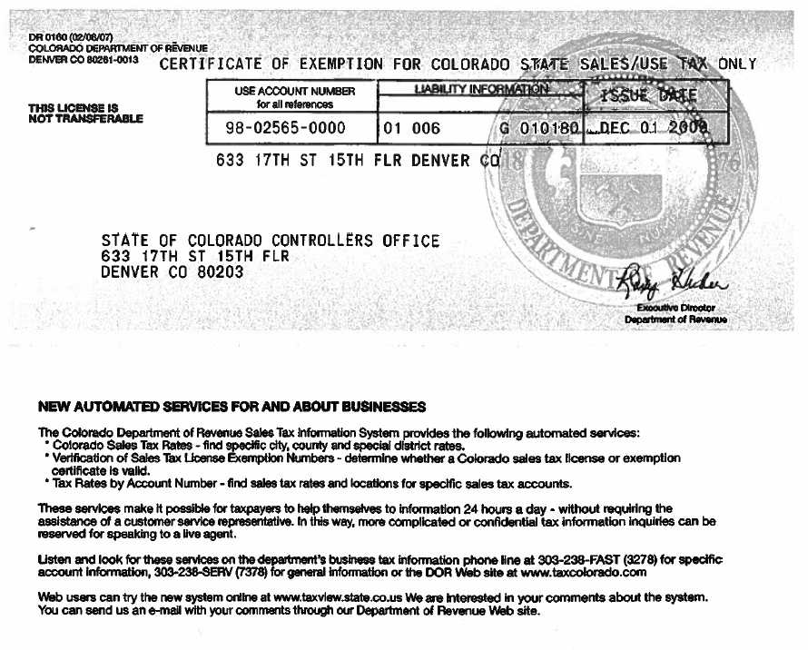

Slide 17
Expense Tracking

Slide 18
ACCOUNTING
Tracking Your Expenses in the Excel Spreadsheet
As CFO of your team you should be tracking your expenses using the excel spreadsheet the finance team will provide you.
If needed we can always schedule a time to go over your team’s finances.
There is a $200 damage deposit already subtracted on your finance tracking excel spreadsheet. This is for the tool kit that was provided for you at the beginning of the year.
We will keep this damage deposit if your team loses or breaks any tools.
No team is exempt from this. We have this damage deposit to ensure future teams will have the tools they need.
If you requested the finance team make a purchase for you (Amazon), the charge will need to go onto your expense tracking excel spreadsheet, not on your Concur report (it will go on the finance team’s Concur report).

Slide 19
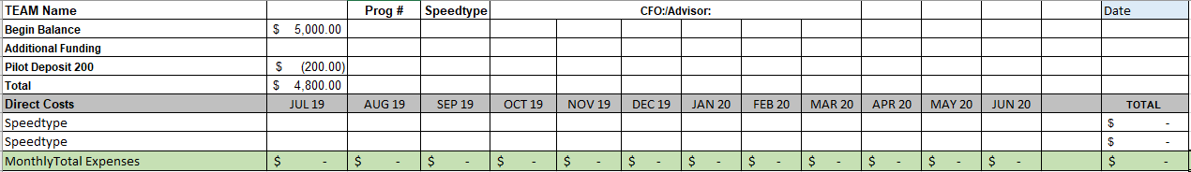
TRACKING SPREADSHEET
Notes:
Tool Kit

Slide 20
Shipping, Close Out, Conference Rooms & Travel

Slide 21
SHIPPING / PACKAGE PICK UP
Do not ship anything to your house.
With 26 teams, we get tons and tons of packages daily. You must put your CFO’s name on it!
Shipping Address:
CFO’s Name (do not use any other team member name or project name)
3775 Discovery Drive
Boulder, CO 80303
Pick-Up
Assign one team member to be the official package pick-up person.
This person will receive an email immediately after a package arrives to the aerospace building (from either Kayla Vandegrift or aerospace@colorado.edu), alerting them to how/when/where to pick up the package.
Please remember: Packages first go to the CU Distribution Center before arriving to the aerospace building, please plan ahead and be patient.
No other team member should be coming into the admin suite with regards to packages.
Billing address:
429 UCB Boulder Colorado 80309- Our billing address has not changed. Distribution is aware of that and will bring items that have our billing address to the new aero building.
Returns: Teams must take care of their own return shipping.

Slide 22
CLOSEOUT
Before coming to Jacqui Stang for closeout, you must have:
All purchasing completed
All Concur reports submitted and approved
A signature from Katie Rae. Katie Rae must sign off before me to ensure that we do not need to charge your teams for lost or broken tools.
Once all of those are completed, Jacqui will collect your p-card and sign off for you.
After Jacqui takes your p-card, you will not be able to get it back, so please make sure you have all of your final printing done beforehand.

Slide 23
CONFERENCE ROOMS
Book the Conference Room before using
Go online to the aerospace website and search ‘conference room,’ book through EMS
All conference rooms are locked up at 5pm. If you need an after- hours key, please book first and then see Kayla Vandegrift in the admin suite.
Plan ahead and be thinking of other buildings, or other ways you can meet as a team, as conference rooms in the aero building are heavily used.

Slide 24
TRAVEL FUNDING
Due to COVID we are unsure if travel is going to an option for your teams at this point in time. As we know more we will let you know.

